Slide 1
Herbert George BLUMER
Dr. Syed Mehdi Abbas Zaidi
Department of Sociology
Shia PG College, Lucknow

Slide 2
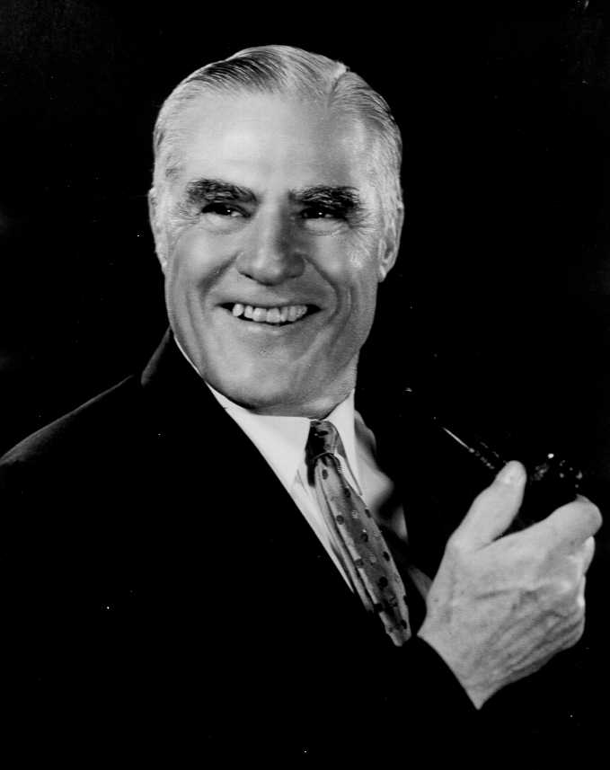
Herbert George Blumer (March 7, 1900 – April 13, 1987)
He was an American sociologist whose main scholarly interests were in symbolic interactionism and methods of social research.
He was an aid interpreter and proponent of George Herbert Mead’s social psychology that he labeled as ‘symbolic interactionism’.
He was also a vociferous critic of positivistic methodological ideas in sociology.

Slide 3
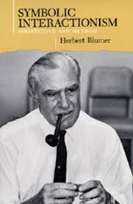
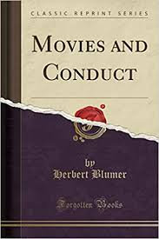
Blumer’s Major Works

Slide 4
Some of Blumer’s Work
1933: Movies, Delinquency, and Crime
1935: The Human Side of Social Planning
1947: Sociological Theory in Industrial Relations
1956: Sociological Analysis and the "Variable”
1958: Race Prejudice as a Sense of Group Position
1980: Theories of Race and Social Action
1969: Symbolic Interactionism: Perspective and Method

Slide 5
Symbolic Interaction Theories
Symbolic Interaction theories focus on the interpretation (social meaning) that is given to behavior, and on the way such interpretation helps to construct the social world, the identities of people, and, ultimately how they behave.
All interaction theories are concerned with the way in which they construct a meaning.
Blumer, Mead’s pupil further developed his theory “Mind, Self, and Society” and coined it as “Symbolic Interactionism” after Mead’s death.

Slide 6
Basic principles
Humans have capacity for thought.
Social interaction helps in shaping the thought.
Interaction help people to learn symbols and meanings that allows them to think.
Symbols and meanings help in performing action.
A person can interpret a situation and modify their action or interaction.
Individuals can create their own meanings.
Societies and groups are made up of patterns of action and interaction.

Slide 7
Three Basic premises of Blumer
Humans act towards things on the basis of the meanings they ascribe to those things.
Meaning of such things is derived from, or arises out of, the social interaction that one has with others and the society.
These meanings are handled in, and modified through, an interpretative process used by the person in dealing with the things he/she encounters.

Slide 8
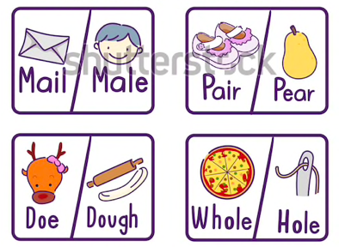
The First Premise: Meaning “ Humans act toward things on the basis of the meanings they ascribe to those things."
It includes everything that a human being may note in their world, including physical objects, actions and concepts. Essentially, individuals behave towards objects and others based on the personal meanings that the individuals has already given these items.

Slide 9
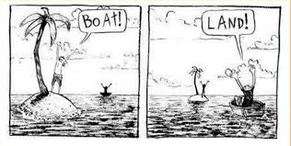
The Second Premises: Language ”The meaning of such things is derived from, or arises out of, the social interaction that one has with others and the society."
It arises out of, the social interaction that one has with other humans. People interact with each other by interpreting or defining each other's actions instead of merely reacting to each other's actions.

Slide 10
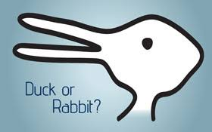
The third premise: Thought "These meanings are handled in, and modified through, an interpretative process used by the person in dealing with the things he/she encounters."
We naturally talk to ourselves in order to sort out the meaning of a difficult situation. But first, we need language. Before we can think, we must be able to interact symbolically. emphasis on symbols, negotiated meaning, and social construction of society brought on attention to the roles people play.

Slide 11
Example of symbolic interactionism
Studies find that teenagers are well informed about the risks of tobacco, but they also think that smoking is cool, that they themselves will be safe from harm, and that smoking projects a positive image to their peers. So, the symbolic meaning of smoking overrides that actual facts regarding smoking and risk.

Slide 12
Conclusion
As per Bulmer:
We as humans have the ability to take the role of the others.
This allows us to chances to find new meaning and different perspectives in life.
That is seeing the world though another’s eyes.
Walking in someone else’s shoes.
Grown up version of having imaginary friends and talking to one’s own self..
Symbolic Interactionism and its premises are built upon the communication between individuals.

Slide 13
Continuum
Languages and thought are vital in the interpretation of symbols.
We have and always will be affected by language and thought.

Slide 14
Thank You

Slide 15
Reference Books
The Methodology of Herbert Blumer, Kenneth Baugh, Jr., Published by- Cambridge University Press (As a Rose Monograph Series).
Symbolic Interactionism: Perspective & Method, Blumer, Herbert, Published by- Prentice Hall.
Books & Canon Building in Sociology: The case of Mind, Self, and Society, Filipe Carreira da Silva and Monica Brito Vieira, Pubished by- Saga Publications.
Human Nature & Collective Behavior papers in honor of Herbert Blumer, Edited by Tamotsu Shibutani, Published by- Transaction Books, New Brunswick, N.J.

